Slide 1

AI Automated Trading System
By: Ahmed Sherif Mohamed Sabry
ID: 21512145
Supervisor: Prof. Mahmoud Atallah

Slide 2

Problem Statement
Trading in financial markets is challenging due to rapid price changes and large amounts of data that need to be analyzed quickly. Human traders may struggle to keep up, leading to delays, mistakes, or emotional decisions.

Slide 3
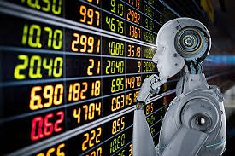
Proposed Solution
Developing an automated trading system that uses machine learning to analyze historical market data and predict stock price movements. The system will generate buy/sell signals to support the trader, while the final decision remains with the human user “Human-in-the-Loop Design”.
The goal is to improve trading speed and accuracy while reducing emotional and rushed decisions.
The system's user-friendly design ensures that both novice and experienced traders can benefit from its features.

Slide 4
Related Work vs Proposed Project Comparison
Feature | Automated Trading System | Hybrid AI Trading Strategies | Stock Price Prediction | Proposed System
Main Focus | Full automation of trading decisions | Improving prediction using multiple models | Predicting stock prices using LSTM | Prediction + Human-approved trading
ML Techniques Used | Not specified | Random Forest, SVM | LSTM | LSTM + Random Forest
Trader Control | Fully automated, no user control | Limited (no interface for control) | No trader involvement | User approves trades manually
Decision Execution | Fully automated | No trade execution | No execution | Generates signals; trader approves
Target Users | Advanced traders | Experienced users | Researchers / Analysts | Both beginners and experts
Limitation Summary | Lacks human judgment, trust issues | Complex, lacks interactive features | No decision support or interface | Relies on past data, possible human bias
Key Advantage Over Others | Speed and full automation | Smarter strategies with hybrid models | High accuracy in price prediction | Combines speed + control + usability
Accuracy / Performance | Not specified (focus on execution) | 92.8% | 94.2% | 0.95 R² on validation 0.94 R² on Test (and they change with the change of stock)
Year | 2019 | 2021 | 2023 | 2025 (Proposed)

Slide 5

System Features
Data collection from financial markets.
Prediction and signal generation.
Trader approval before execution.
Web-based interactive interface.

Slide 6
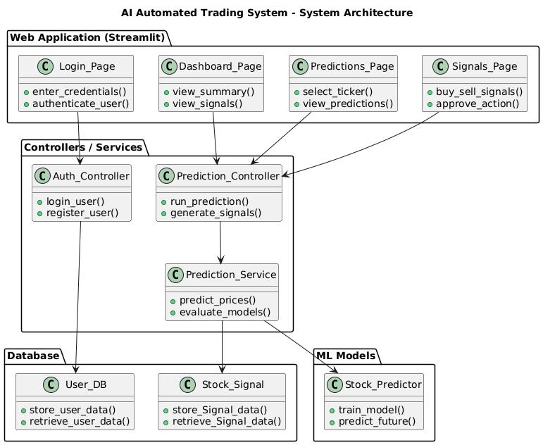
System Architecture

Slide 7
Requirements
Functional Requirements:
The system shall collect and store historical market data.
The system shall analyze data and generate Buy/Sell trading signals.
The system shall allow the trader to review and approve signals before execution.
The system shall provide a web-based user interface for interaction.
The system shall display prediction results in a clear and understandable form.
Non-Functional Requirements:
The system shall provide accurate and reliable predictions.
The system shall respond quickly to user actions.
The system shall be easy to use, even for non-technical traders.
The system shall ensure data security and system reliability.

Slide 8
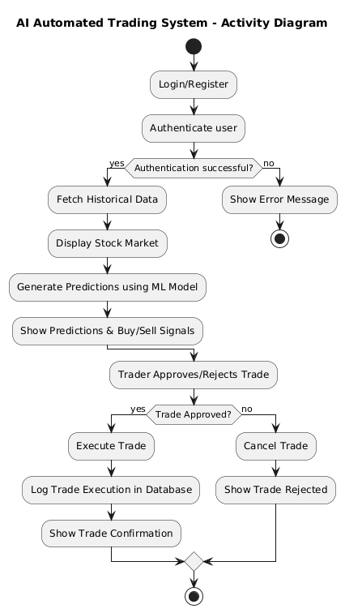
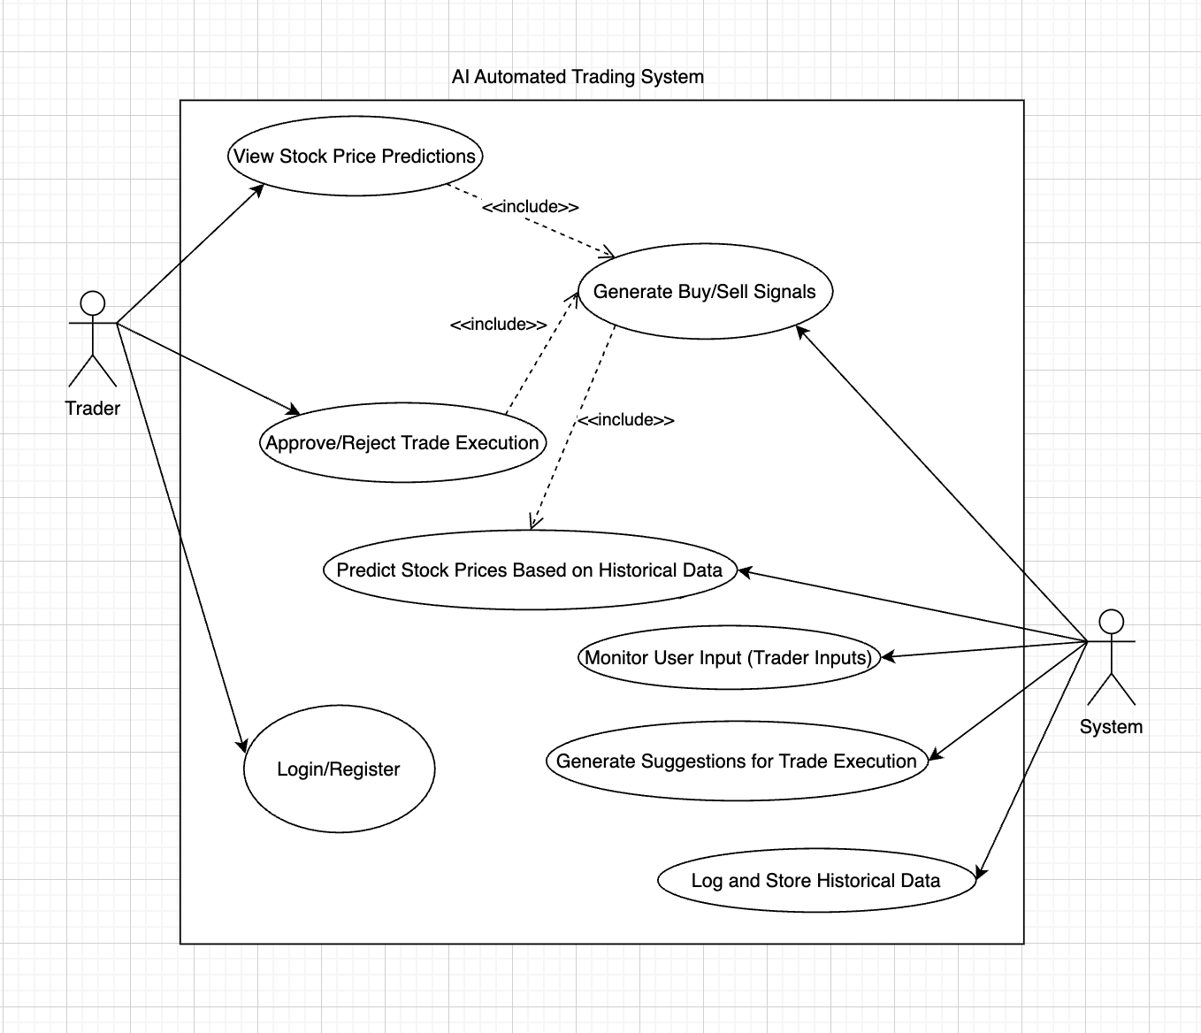
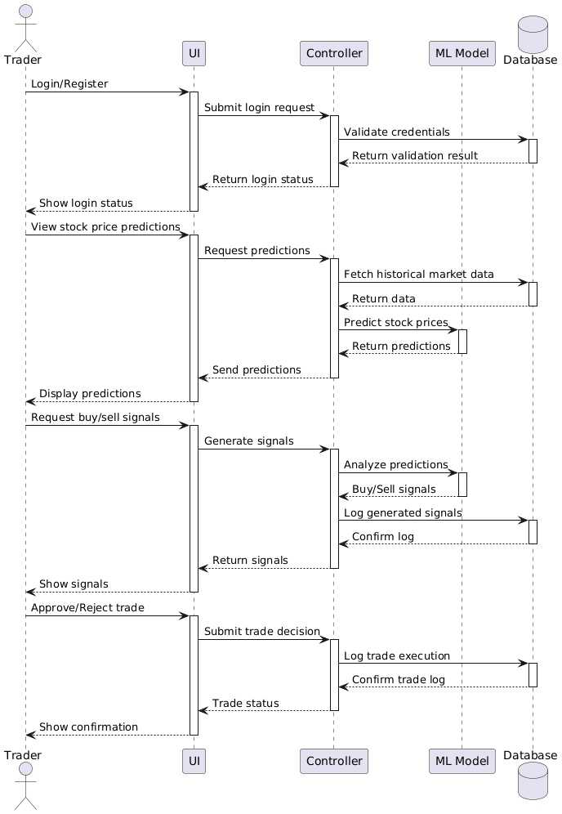
Diagrams
Use case Diagram
Sequence Diagram
Activity Diagram

Slide 9
Software and Hardware Requirements
Software Requirements
Programming Language: Python 3.10
IDE / Development Tools: PyCharm Code, Google Colab Notebook
Web Framework: Streamlit (for interactive web application)
Machine Learning Libraries: Scikit-learn, TensorFlow / Keras
Data Handling & Processing: Pandas, NumPy
Data Scaling & Preprocessing: MinMaxScaler (Scikit-learn)
Model Saving & Loading: joblib
Market Data Integration: yfinance (historical market data)
Visualization: Matplotlib
Testing & Debugging: Logging, basic validation and error handling
Hardware Requirements
RAM: Minimum 8 GB (16 GB recommended for better performance)
Storage: At least 500 MB free space for datasets, trained models, and logs
Internet Connection: Required for fetching live and historical market data
Processor: Multi-core processor (minimum Intel i5 or equivalent)

Slide 10
Implementation
The user interface is implemented using Streamlit, providing an interactive web-based application that follows a dark-mode theme with responsive layout and intuitive navigation via tabs. Key features include:
Splash Screen: Displays the project logo at startup welcoming users before accessing the app.
Authentication: Users can login or register via a secure interface. Credentials are stored in the SQLite database.
Navigation Tabs: Users can switch between Dashboard, Predictions, and Signals pages.
Dashboard Page: Displays historical stock data in a Plotly chart and tabular format for the last 100 entries.
Predictions Page: Users can select a stock ticker and forecast horizon. The hybrid ML model runs predictions, displaying future prices, signals, and metrics.
Signals Page: Pending signals can be approved or rejected with dynamic status badges. Historical signals are also displayed. Signals have a lifecycle: PENDING → APPROVED/REJECTED
ML Pipeline:
  LSTM Model: Predicts future stock prices from historical sequences.
  Random Forest Residuals: Refines predictions to improve test performance.
  Evaluation: Metrics such as MAE, RMSE, and R² are calculated.
Database Schema:
  users: Stores usernames and hashed passwords for authentication.
  signals: Stores trading signals with columns for ticker, type, confidence, status, and created_at.

Slide 11
Challenges
Inconsistent and missing stock market data
Prediction accuracy affected by market volatility
Integration of ML models with UI and database

Slide 12
Future Work
Live market data integration.
More advanced AI models.
Risk management module.
Mobile application support.

Slide 13
Conclusion
The project successfully achieved its main objectives:
Automating stock data analysis
Generating trading signals based on predictions
Reducing emotional and rushed trading decisions
Maintaining human control over final trade actions.

Slide 14
References
[1] Li, Z., Yu, H., Xu, J., Liu, J., & Mo, Y., 2023. Stock Market Analysis and Prediction Using LSTM: A Case Study on Technology Stocks. Innovations in Applied Engineering and Technology, 2(1), pp.1-6. https://doi.org/10.62836/iaet.v2i1.162.
[2] Moghar, A. & Hamiche, M., 2020. Stock Market Prediction Using LSTM Recurrent Neural Network. Procedia Computer Science, 176, pp.2766-2775. https://doi.org/10.1016/j.procs.2020.09.319.
[3] Mendoza, L. & Zhang, M., 2019. Design of an Automated Stock Trading System Using Artificial Intelligence. International Journal of Financial Engineering, [online] Available at: https://www.tandfonline.com [Accessed 5 May 2025].
[4] Liu, J., et al., 2021. AI-Based Hybrid Stock Trading System Using Random Forest and Support Vector Machines. Financial Innovation, [online] Available at: https://link.springer.com/article/10.1186/s40854-021-00288-1 [Accessed 5 May 2025].
[5] Python Official Website. (n.d.). Python.org. Available at: https://www.python.org/ [Accessed 5 May 2025].
[6] Scikit-learn Machine Learning Library. (n.d.). Scikit-learn. Available at: https://scikit-learn.org/ [Accessed 5 May 2025].
[7] Investopedia. (n.d.). AI in Trading. Available at: https://www.investopedia.com/ [Accessed 5 May 2025].
[8] Medium. (n.d.). Articles about AI Trading (general reading). Available at: https://medium.com/ [Accessed 5 May 2025].
[9] Yahoo Finance and Kaggle. (n.d.). Example Datasets. Available at: https://www.yahoo.com/finance and https://www.kaggle.com/ [Accessed 5 May 2025].
[10] PlantUML. (n.d.). PlantUML. Available at: https://plantuml.com/ [Accessed 5 May 2025].
[11] draw.io. (n.d.). draw.io (diagrams.net). Available at: https://app.diagrams.net/ [Accessed 5 May 2025].

Slide 15
Thank You

